Slide 1

EEE 400 PROGRESS REPORT PRESENTATION (FINAL TERM)
Use of Hybrid Plasmonic Nanoparticle Systems to Enhance the Opto-Electronic Performance of Thin-Film Solar Cells
Presented by:
Shahriar Islam, Jawad Hasan, S. M. Nayeem Arefin
Department of Electrical & Electronic Engineering
INDEPENDENT UNIVERSITY, BANGLADESH
Supervisor: Mustafa Habib Chowdhury, PhD, SMIEE
Jawad Hasan Use of hybrid plasmonic nanoparticle Page ‹#›/29

Slide 2
Outline
Background and Motivation
  Solar cell
  Existing PV technologies (Problems and Solutions).
  Understanding and Utilizing Hybrid Plasmonic Nanostructures.
Problem Statement, Objectives and Addressing complex engineering problems and activities
Research Methodology and Proposed Simulation Setup
Modeling of Nanoparticle Configurations
Performance Parameters
Results and Analysis
Impact of Project on Environment and Sustainability
Limitations
Summary
Future Works
Jawad Hasan Use of hybrid plasmonic nanoparticle Page ‹#›/29

Slide 3
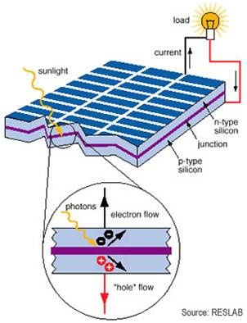
Background and Motivation
Efficiency of 1st generation Solar cells (15-20%).
40% cost is the bulk material.
Need to reduce the cost and increase
the efficiency.
TFSC uses less bulk material so costs less.
Different Light trapping techniques
Plasmonic Metallic Nanoparticle
Jawad Hasan Use of hybrid plasmonic nanoparticle Page ‹#›/29

Slide 4
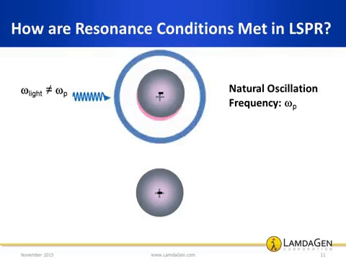
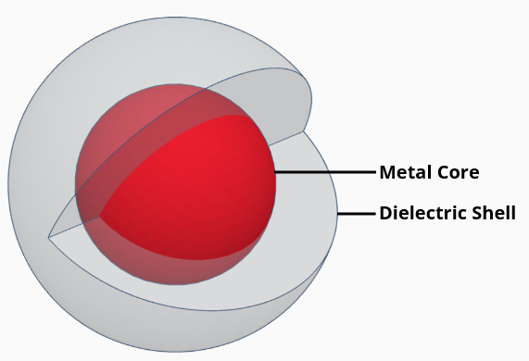
Background and Motivation (contd..)
Core-Shell Nanostructure Plasmonic Characteristics
  Electrical & chemical isolation
  Tunable scattering direction
Absorbing substrate has a large volume that can be exploited to increase solar cell performance.
Metal-Dielectric interface is needed for SPR.
Embedding Core-Shell nanoparticle in Si ensures a metal-dielectric interface for SPR.
Jawad Hasan Use of hybrid plasmonic nanoparticle Page ‹#›/29

Slide 5
Background and Motivation (Literature Review)
Sl | Reference (Journal / Conference papers | Outcome | Limitations / Problems / Challenging issues | Possible Solution
1. | Bouhafs D., Moussi A., Chikouche A., and Ruiz J.M., 1998. Design and simulation of antireflection coating systems for optoelectronic devices: Application to silicon solar cells. Solar Energy Materials and Solar Cells 52(1-2): 79-93. | Design with ARC resulted in higher J_{SC} by decreasing the reflectance of the incident light. | Complex design and high cost of fabrication due to the need for expensive equipment and precise control required for layer synthesis. | Nanostructures like nanopillars can be utilized that are relatively cheaper to fabricate and can also reduce Fresnel reflectivity.
2. | Lin G.R., Chang Y.C., Liu E.S., Kuo H.C., and Lin H.S., 2007. Low refractive index Si nanopillars on Si substrate. Applied Physics Letters 90(18): 181923. | The use of Silicon nanopillar array leads to an air/Si interface with a roughened surface which reduces reflectivity to very low levels in the wavelength range of 320nm to 1620nm. | Increased surface recombination and reduction in the amount of charge carries. This resulted in less current generation. | Utilize plasmonic metal nanoparticles capable of high light confinement and low surface recombination.
Jawad Hasan Use of hybrid plasmonic nanoparticle Page ‹#›/29

Slide 6
Background and Motivation (Literature Review)
Sl | Reference (Journal / Conference papers | Outcome | Limitations / Problems / Challenging issues | Proposed Solution
3. | Mehrfar, F., Heidarzadeh, H., 2018. Effect of size non-uniformity on performance of a plasmonic perovskite solar cell: an array of embedded plasmonic nanoparticles with the Gaussian distribution radiuses. Plasmonics, 13(6), pp.2305-2312. | The use of embedded nanoparticles in the absorbing layer of the thin-film cell resulted in better J_{SC}, V_{OC,} FF and η values when compared to the bare substrate. | Unlike the perovskite solar cells, in the silicon solar cell when particles are embedded inside the absorber layer, SPR does not occur as there is no metal dielectric interface. | Use Core-shell NP to embedd in the absorbing substrate to facilitate SPR for better results.
Jawad Hasan Use of hybrid plasmonic nanoparticle Page ‹#›/29

Slide 7
Problem Statement & Objective
After literature review, the following major problems are discovered and needed to be addressed:
Low opto-electronic performance due to the reduced thickness of TFSCs.
Need for better light trapping techniques.
The objective of the project is to:
Use engineering principles to design hybrid plasmonic nanostructures to increase light confinement in Si substrate to ultimately increase the opto-electronic performance of thin-film solar cells.
Find the optimal nanoparticle configuration for incorporation into thin film solar cell to increase efficiency.
Jawad Hasan Use of hybrid plasmonic nanoparticle Page ‹#›/29

Slide 8
Addressing complex engineering problems
Complex Engineering Problems |  | Addressing the complex engineering problems in the project
WP1 | Depth of knowledge required (WK3-WK5, WK8) | The project requires knowledge of the current state of the energy sector and the PV potential of Bangladesh(WK8), existing thin-film solar cell technologies(WK7,WK8) , physics of plasmonic nanostructures(WK1), plasmonic solar cell design parameters(WK3-WK5), and PV industry standards(WK6).
WP2 | Range of conflicting requirements | No conflicting requirements.
WP3 | Depth of analysis required | Several opto-electronic analyses (extinction spectra analysis, optical absorption enhancement factor analysis, short-circuit current analysis, optical near-field analysis, etc.) were carried out to determine an optimal design.
WP4 | Familiarity of issues | The project involves fundamental concepts associated with electrical engineering (photovoltaics, photonics, plasmonics, solid state physics, etc.).
WP5 | Extent of applicable codes | IEC 61646 - STC (ASTM G-173/AM 1.5G, 300K, 1000W/m^2).
WP6 | Extent of stakeholder involvement | Solar cell manufacturers like Hanergy Thin-Film, SwiftSolar, Freschfield, JA Solar, SunPower Corp., Rahimafrooz Renewable Energy LTD, Greenfinity Energy LTD, etc.
WP7 | Interdependence | Project involves interdependence between different branch of physics and electrical engineering (plasmonics, photonics and photovoltaics).
Jawad Hasan Use of hybrid plasmonic nanoparticle Page ‹#›/29

Slide 9
Addressing Complex Engineering Activities
Complex Engineering Activities |  | Addressing the complex engineering activities in the project
EA1 | Range of resources | Funds for license of commercial grade simulation software FDTD and DEVICE, Utilized peer-reviewed journal articles, peer-reviewed conference proceedings, course content (EEE 313), online resources, and semiconductor physics text books.
EA2 | Level of interactions | Subsystems: 1) Core-shell NPs of varying shell thickness 2) Embedding Core-shell NP inside the Si absorbing layer 3) Morphological study 4) Sandwich configuration 5) Arrays of embedded core-shell NPs 5) Arrays of Sandwich configuration.
EA3 | Innovation | The proposed hybrid nanoparticle system comprising an homogenous nanoparticle, embedded core-shell nanoparticle and “sandwich” configuration are all novel designs pushing the boundaries of current plasmonic thin-film solar cell technologies, as evident from the results obtained.
EA4 | Consequences to society / environment | The project was found to be sustainable and eco-friendly in terms of resources utilized. Studies showed adoption of the technology researched in the project will have a direct positive effect by potentially reducing carbon emissions and fossil fuel use, which can aid in the betterment of the health of the people, and help in the development of community/society as a whole.
EA5 | Familiarity | The project builds upon existing works of thin-film solar cell design but also delves into unexplored fields of plasmonics and nanoparticle physics to meet the outcomes and objectives.
Jawad Hasan Use of hybrid plasmonic nanoparticle Page ‹#›/29

Slide 10
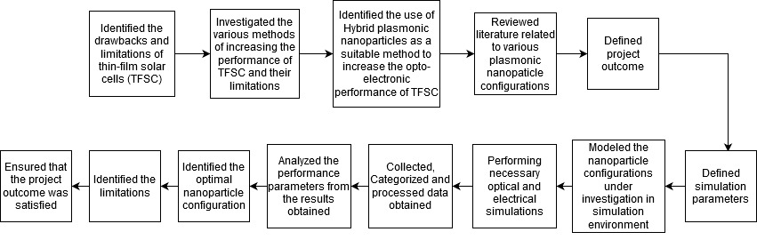
Research Methodology
Literature Review
Results and Analysis
Simulation
Modeling
Shahriar Islam Use of hybrid plasmonic nanoparticle Page ‹#›/29

Slide 11
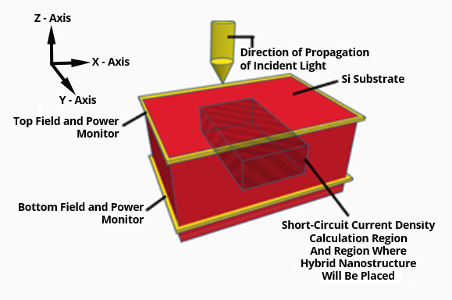
Simulation Setup
Simulation Software: FDTD Solutions and DEVICE
◦Temp: 300K
◦Boundary Condition: PML
◦Source: Solar Spectral Irradiance AM 1.5G
◦λ= 300-800 nm with 150 frequency points
◦Mesh type: Conformal Mesh
◦Mesh size: 2nm
◦Total-Field-Scattered-Field(TFSF) Source for calculating Extinction Spectra.
Figure: FDTD Simulation setup for optical absorption enhancement (g) analysis, utilizing frequency domain field and power monitors.
Shahriar Islam Use of hybrid plasmonic nanoparticle Page ‹#›/29

Slide 12
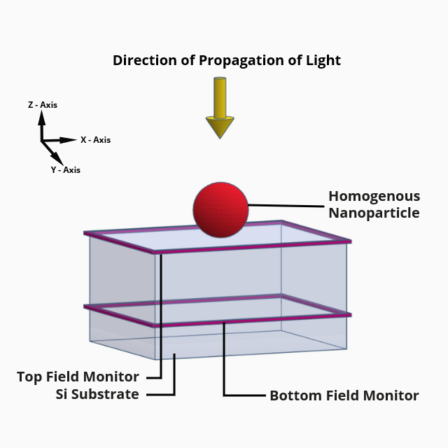
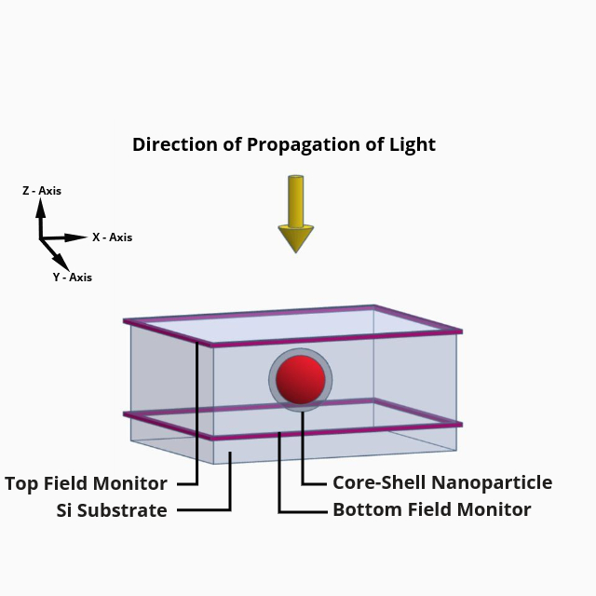
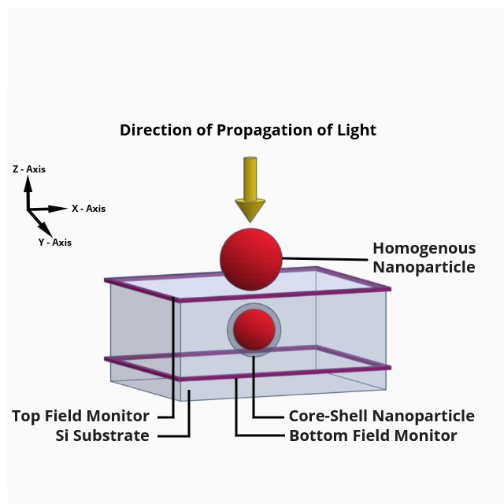
Modeling of Nanoparticle Configurations
Homogenous Ag Nanoparticle on Top of the substrate.
Embedded Ag-Core Silica-Shell Nanoparticle inside the substrate.
"Sandwich" configuration comprising Homogenous Ag Nanoparticle on Top of the Substrate and Embedded Core-Shell Nanoparticle inside the substrate.
Shahriar Islam Use of hybrid plasmonic nanoparticle Page ‹#›/29

Slide 13
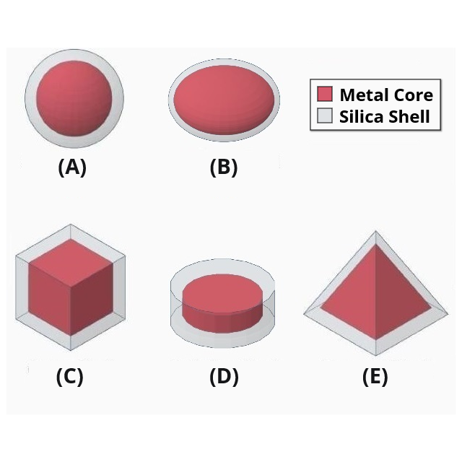
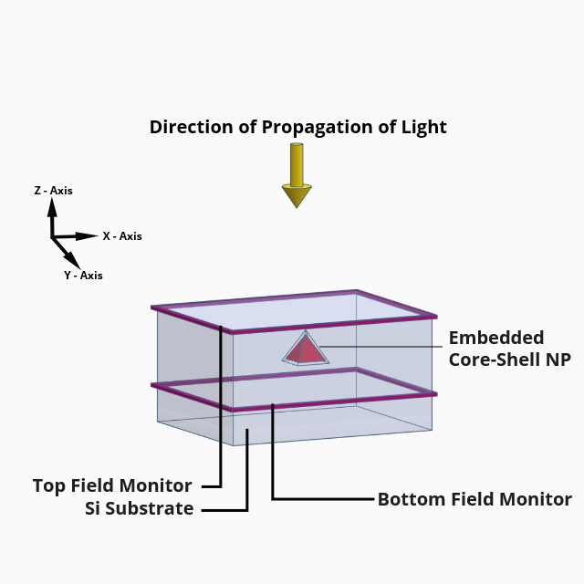
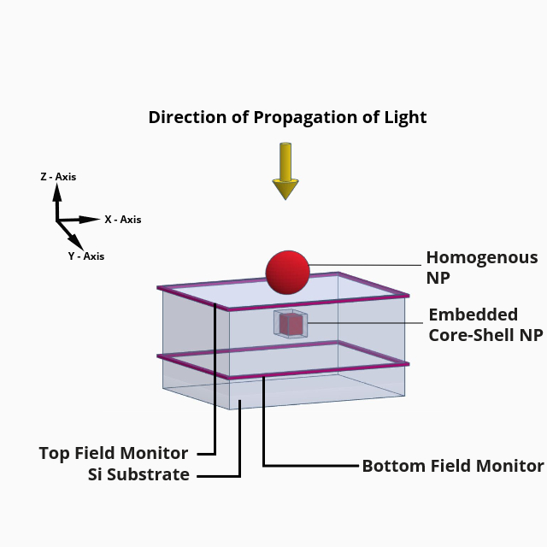
Modeling of Nanoparticle Configurations
Various shapes of core-shell nanoparticles.
Embedded Pyramidal Ag-Core Silica-Shell Nanoparticle inside the substrate.
"Sandwich" configuration comprising Homogenous Ag Nanoparticle on Top of the Substrate and Embedded Cubical Core-Shell Nanoparticle.
Shahriar Islam Use of hybrid plasmonic nanoparticle Page ‹#›/29

Slide 14
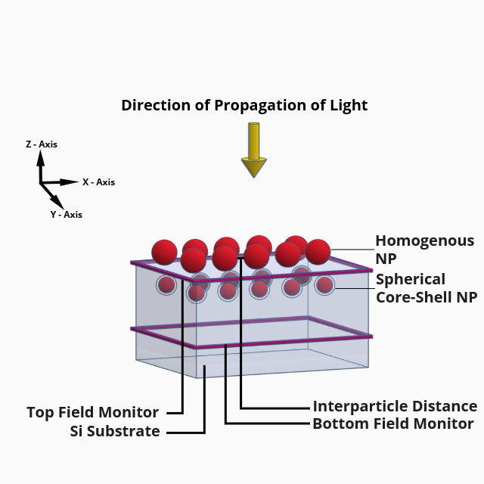
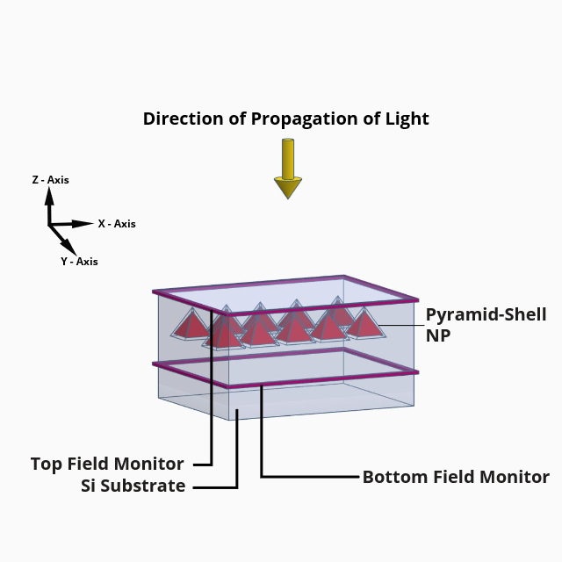
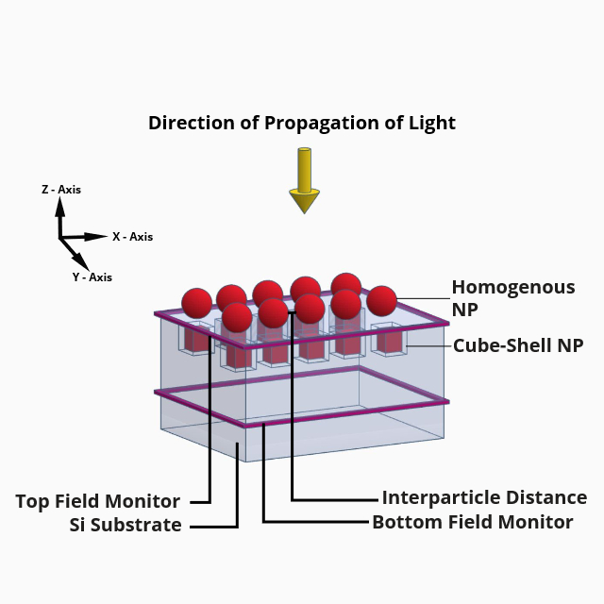
Modeling of Nanoparticle Configurations
Array of Homogenous Ag Nanoparticles on Top of the Substrate and Embedded Spherical Core-Shell Nanoparticles in “Sandwich” Configuration.
Array of Embedded Pyramidal Ag-Core Silica-Shell Nanoparticles inside the substrate.
Array of Homogenous Ag Nanoparticles on Top of the Substrate and Embedded Cubical Core-Shell Nanoparticles in “Sandwich” Configuration.
Shahriar Islam Use of hybrid plasmonic nanoparticle Page ‹#›/29

Slide 15
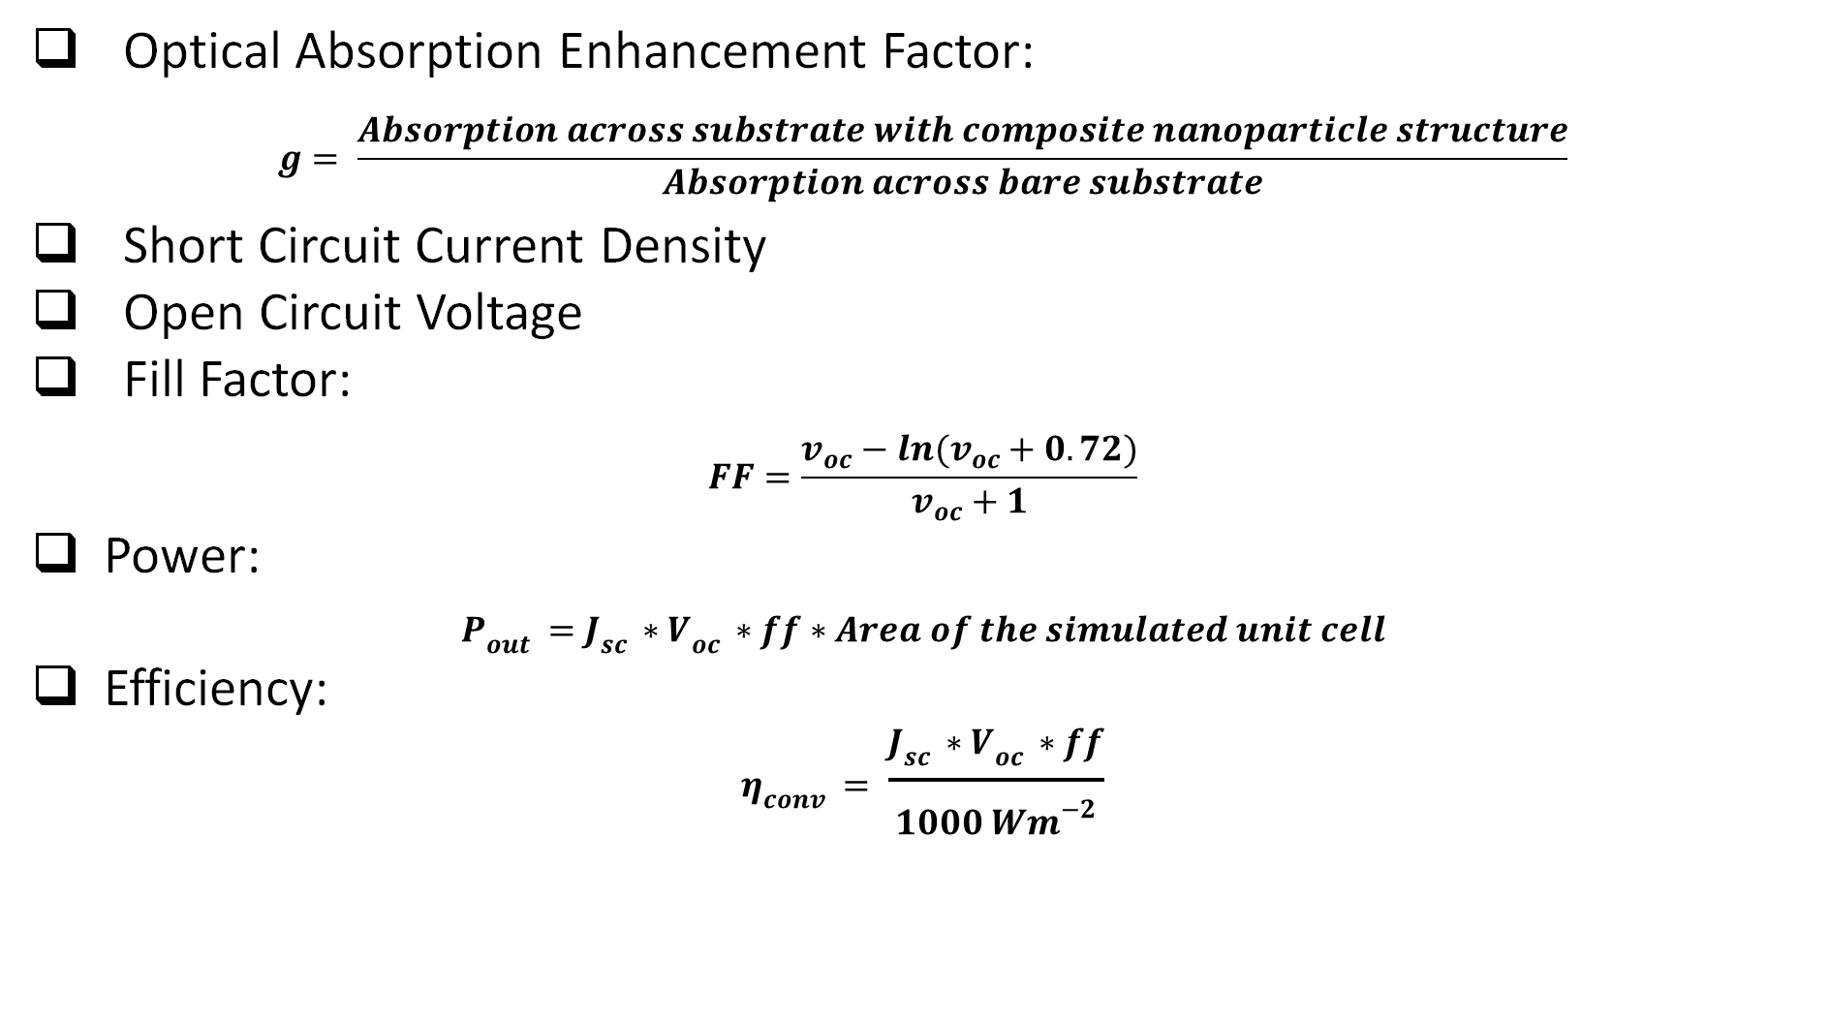
Performance Parameters
Shahriar Islam Use of hybrid plasmonic nanoparticle Page ‹#›/29

Slide 16
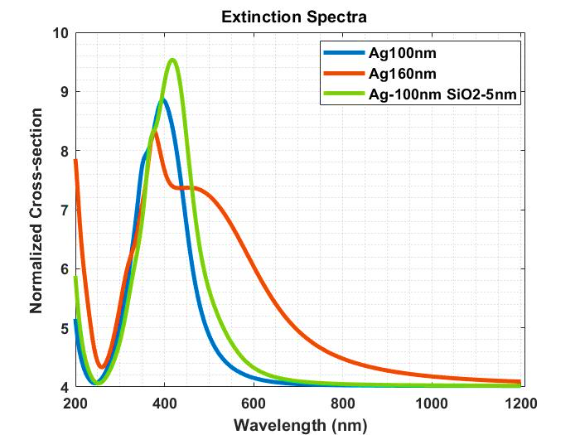
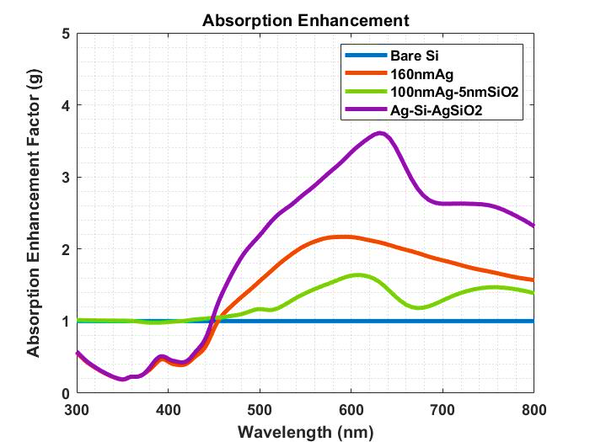
Results and Analysis (*Tensymp)
Figure: Extinction spectra for 100nm Ag NP, 160nm Ag NP and a Core-Shell (Ag-SiO₂) nanoparticle with a 100nm diameter core and shell thickness of 5nm.
Figure: Optical absorption enhancement factor (g) plots for Bare Si, AgNP(160nm), Ag(100nm)-SiO₂(5nm) and, Ag-Si-SiO₂.
Shahriar Islam Use of hybrid plasmonic nanoparticle Page ‹#›/29

Slide 17
Results and Analysis (contd.) (*Tensymp)
TABLE.2. Short-circuit current (J_{sc}) and optical absorption enhancement factor (g) results for homogenous NP (on top of the substrate) and core-shell NP (embedded inside the substrate) in “sandwich” configuration (Ag-Si-AgSiO₂).
TABLE. 1. Short-circuit current (J_{sc}) and absorption enhancement factor (g) results for homogenous nanoparticle configuration (Ag) on top of the silicon substrate.
Diameter of Homogenous Ag NP with constant diameter of Core-Shell NP (Ag “core” = 100nm; SiO₂ “shell thickness” = 5nm) | Absorption Enhancement Factor (g) | Short Circuit Current Density (J_{sc}) A/m²
Bare Silicon | 150 | 6.83715
50nm | 169.9328 | 6.79422
60nm | 170.1376 | 6.90140
70nm | 171.1742 | 7.07376
80nm | 173.0364 | 7.27431
90nm | 177.2691 | 7.58498
100nm | 180.8094 | 7.74023
110nm | 190.5009 | 8.29161
120nm | 195.4238 | 8.47945
130nm | 200.9300 | 8.57800
140nm | 206.9754 | 8.75503
150nm | 209.6555 | 8.71114
160nm | 213.4540 | 9.32057
170nm | 210.0586 | 8.45435
180nm | 205.4645 | 8.12931
190nm | 201.8373 | 7.96339
200nm | 194.1730 | 7.61642
250nm | 149.6815 | 6.31563
Diameter of Homogenous Ag NP | Absorption Enhancement Factor (g) | Short Circuit Current Density (J_{sc}) A/m²
Bare Silicon | 150 | 6.83715
100nm | 146.8064616 | 7.63372
110nm | 153.4010493 | 8.31515
120nm | 155.5968682 | 8.62153
140nm | 161.0589566 | 8.74822
150nm | 161.5535060 | 8.80499
160nm | 163.1588479 | 9.13718
180nm | 157.3498997 | 8.09358
200nm | 149.4768296 | 7.54844
Shahriar Islam Use of hybrid plasmonic nanoparticle Page ‹#›/29

Slide 18
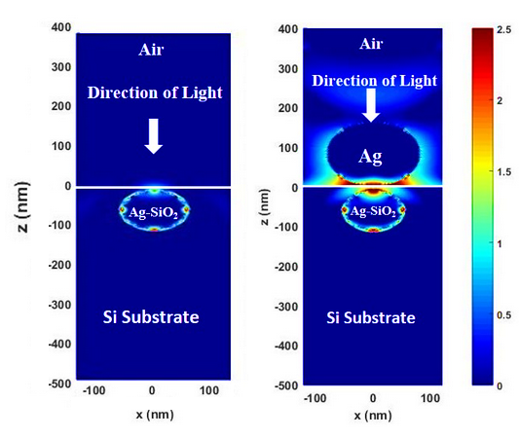
Results and Analysis (contd.) (*Tensymp)
TABLE. 3. Optical absorption enhancement, short circuit current density (J_{sc}), open circuit voltage (V_{oc}), output power, fill factor (FF) and efficiency (n) for bare silicon substrate, homogenous nanoparticle configuration (Ag), embedded core-shell nanoparticle configuration (Ag-SiO₂), and “Sandwich” configuration (Ag-Si-AgSiO₂).
Configuration | Absorption Enhancement Factor (g) | Short-Circuit Current Density (J_{sc}) A/m² | Open circuit Voltage (V_{oc}) V | Fill Factor (FF) | Power (x10⁻⁹) mW | Efficiency Increase (n) %
Bare Si | 150.00 | 6.837 | 0.3954 | 0.7684 | 1.629 | -
Ag (160nm) | 163.16 | 9.137 | 0.3962 | 0.7687 | 2.182 | 33%
Ag-SiO₂ (100nm Ag core; 5nm SiO₂ shell) | 172.76 | 6.913 | 0.3962 | 0.7687 | 1.651 | 0.96%
Sandwich (Ag-Si-AgSiO₂) | 213.45 | 9.321 | 0.3980 | 0.7695 | 2.238 | 36.4%
Figure: Near-field images illustrating the electromagnetic field patterns for (a) Embedded core-shell nanoparticle configuration, and (b) Homogenous and core-shell nanoparticle in “Sandwich” configuration.
Shahriar Islam Use of hybrid plasmonic nanoparticle Page ‹#›/29

Slide 19
Results and Analysis (*UIU)
table: optical absorption enhancement (g) and short-circuit current density (j_{sc}) in a/m² for core-shell particles with varying shell thickness
NP | 2nm shell |  | 5nm shell |  | 8nm shell |  | 10nm shell
 | g | J_{sc} | g | J_{sc} | g | J_{sc} | g | J_{sc}
Cube | 288 | 2.68 | 287 | 2.55 | 293 | 2.67 | 303 | 2.54
Cylinder | 305 | 2.44 | 302 | 2.33 | 309 | 2.30 | 324 | 2.25
Pyramid | 255 | 2.79 | 254 | 3.03 | 252 | 2.26 | 251 | 2.03
Sphere | 182 | 1.99 | 175 | 2.01 | 172 | 1.89 | 171 | 1.85
Spheroid | 192 | 1.97 | 192 | 1.83 | 189 | 1.50 | 189 | 1.77
S. M. Nayeem Arefin Use of hybrid plasmonic nanoparticle Page ‹#›/29

Slide 20
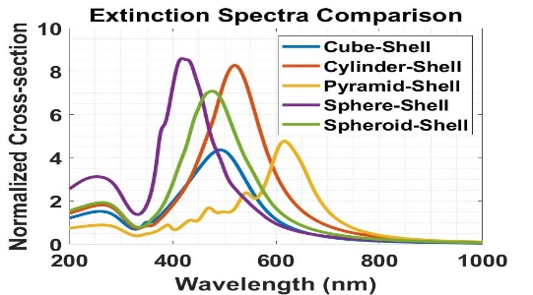
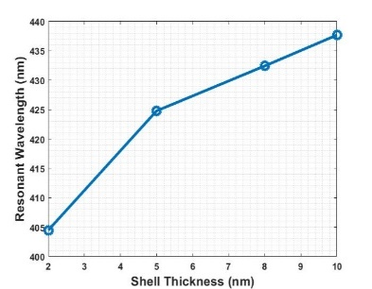
Results and Analysis (*UIU)
Figure: Extinction spectra for various shapes of Core-Shell (Ag-SiO₂) nanoparticle with a constant core volume of 5.23*10⁶ nm³.
Figure: Shift in the plasmon resonance wavelength for a spherical Ag core-silica shell NP as a function of the shell thickness
S. M. Nayeem Arefin Use of hybrid plasmonic nanoparticle Page ‹#›/29

Slide 21
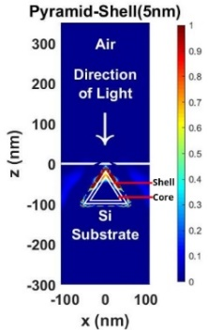
Results and Analysis (*UIU)
Table: g, J_{sc}, V_{oc}, FF, Power and Increase in Efficiency (n) for silver-core dielectric-shell NPs of different shapes that are embedded inside the silicon absorbing substrate with optimum shell thickness.
Particle | Absorption Enhancement Factor (g) | Short Circuit Current Density (J_{sc}) A/m² | Open Circuit Voltage (V_{OC}) V | Fill Factor (FF) | Power W/m² | Increase in Efficiency (n) %
Cube-Shell(2nm) | 288.1197 | 2.68193 | 0.394666 | 0.768 | 0.813 | 0.49%
Cylinder-Shell(2nm) | 304.6651 | 2.73952 | 0.394613 | 0.768 | 0.739 | 9.55%
Pyramid-Shell(5nm) | 253.6446 | 3.03527 | 0.394877 | 0.7681 | 0.921 | 12.73%
Sphere-Shell(5nm) | 175.1565 | 2.94381 | 0.394926 | 0.7681 | 0.893 | 9.30%
Spheroid-Shell(2nm) | 192.9648 | 2.88425 | 0.394837 | 0.7681 | 0.875 | 6.85%
Bare Silicon (no NPs) | 150 | 2.69507 | 0.394702 | 0.768 | 0.817 | -
Figure: Optical near-field enhancement image along the x-z plane for (A) Pyramidal core-shell NP
S. M. Nayeem Arefin Use of hybrid plasmonic nanoparticle Page ‹#›/29

Slide 22
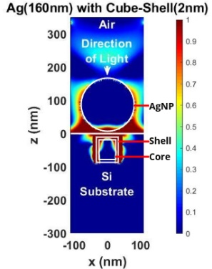
Results and Analysis (*UIU)
Table: g, J_{sc}, V_{oc}, and FF for “Sandwich” configuration of particles with homogeneous Ag NP on top of the silicon substrate and core-shell NPs embedded inside the substrate.
AgNP(160nm) with | Absorption Enhancement Factor (g) | Short Circuit Current Density (J_{sc}) A/m² | Open Circuit Voltage (V_{OC}) V | Fill Factor (FF)
Cube-Shell(2nm) | 254.4213 | 6.69025 | 0.396226 | 0.7686
Cylinder-Shell(2nm) | 254.4930 | 5.82870 | 0.396122 | 0.7686
Pyramid-Shell(5nm) | 243.6763 | 6.34719 | 0.395843 | 0.7685
Sphere-Shell(5nm) | 246.3495 | 5.08215 | 0.395743 | 0.7684
Spheroid-Shell(2nm) | 249.0992 | 4.52333 | 0.395432 | 0.7683
Bare Silicon (no NPs) | 150 | 2.69507 | 0.394702 | 0.7686
Figure: Optical near-field enhancement image for optimal sandwich configuration.
S. M. Nayeem Arefin Use of hybrid plasmonic nanoparticle Page ‹#›/29

Slide 23
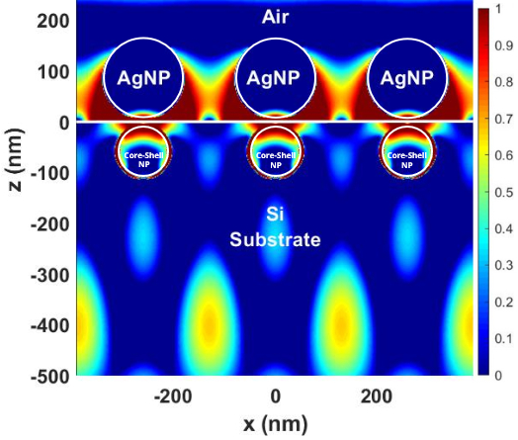
Results and Analysis (*Array)
Pitch (side to side) (nm) for “Sandwich” Configuration of Homogenous NP on Top and Embedded Spherical Core-Shell NP | Absorption Enhancement Factor (g) | Short-Circuit Current Density (J_{sc}) A/m²
Bare | 150.0000 | 61.7538
5 | 138.5469 | 41.9263
10 | 175.1006 | 42.6641
20 | 258.7007 | 62.7695
40 | 330.1305 | 81.0771
50 | 350.1785 | 86.1495
60 | 365.6656 | 90.0097
80 | 388.0258 | 94.8123
100 | 384.6802 | 101.453
150 | 295.254 | 98.8361
200 | 288.7069 | 101.723
250 | 279.0321 | 100.886
300 | 256.4169 | 94.4037
350 | 236.3303 | 86.3897
400 | 220.7681 | 80.9711
Figure: Optical near-field enhancement image for current “Sandwich” configuration with optimal pitch size.
S. M. Nayeem Arefin Use of hybrid plasmonic nanoparticle Page ‹#›/29

Slide 24
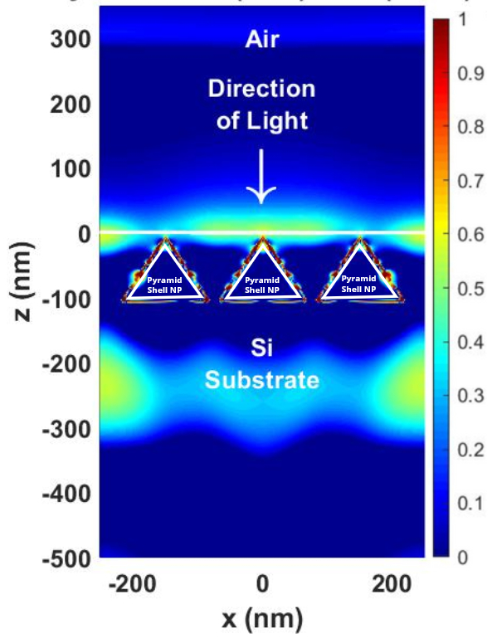
Results and Analysis (*Array)
Pitch (side to side) (nm) for Embedded Pyramidal Core-Shell NP | Absorption Enhancement Factor (g) | Short-Circuit Current Density (J_{sc}) A/m²
Bare | 150 | 61.7535
5 | 1111.859 | 195.782
10 | 972.8968 | 201.269
20 | 894.523 | 190
40 | 776.499 | 176.061
50 | 715.301 | 167.302
60 | 656.419 | 158.705
80 | 547.389 | 142.535
100 | 456.413 | 128.322
150 | 324.621 | 101.43
200 | 297.9637 | 93.3296
250 | 287.875 | 89.9237
300 | 258.235 | 89.9237
350 | 244.315 | 79.8733
400 | 230.188 | 77.2909
Figure: Optical near-field enhancement image for embedded pyramid-shell NPs with optimal pitch size.
S. M. Nayeem Arefin Use of hybrid plasmonic nanoparticle Page ‹#›/29

Slide 25
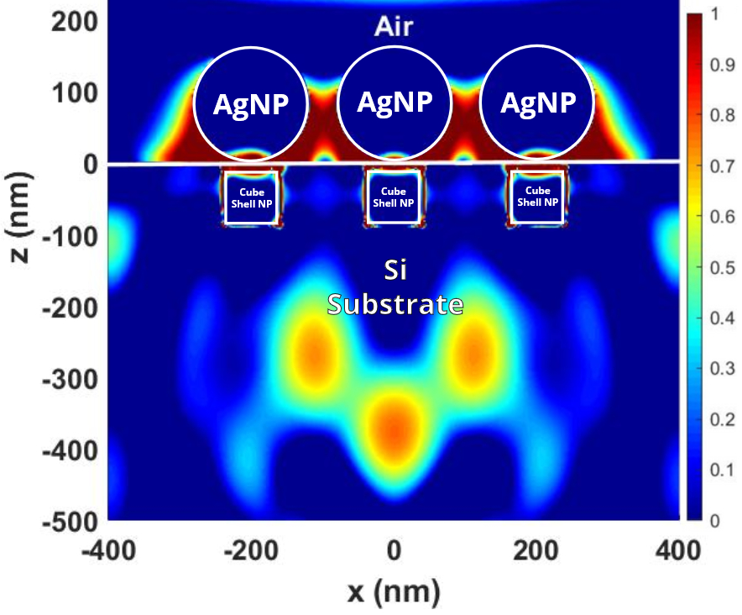
Results and Analysis (*Array)
Pitch (side to side) (nm) for “Sandwich” Configuration of Homogenous NP on Top and Embedded Cubical Core-Shell NP | Absorption Enhancement Factor (g) | Short-Circuit Current Density (J_{sc}) A/m²
Bare | 150 | 61.7538
5 | 407.295 | 82.5288
10 | 518.2948 | 138.868
20 | 879.8739 | 232.07
40 | 1116.708 | 292.807
50 | 1103.067 | 290.122
60 | 1043.527 | 276.771
80 | 881.8516 | 243.935
100 | 723.053 | 215.547
150 | 489.5965 | 180.792
200 | 445.378 | 169.823
250 | 409.5997 | 158.86
300 | 364.2683 | 142.678
350 | 331.6488 | 125.668
400 | 301.8291 | 112.93
Figure: Optical near-field enhancement image for the current “Sandwich” configuration with optimal pitch size.
S. M. Nayeem Arefin Use of hybrid plasmonic nanoparticle Page ‹#›/29

Slide 26
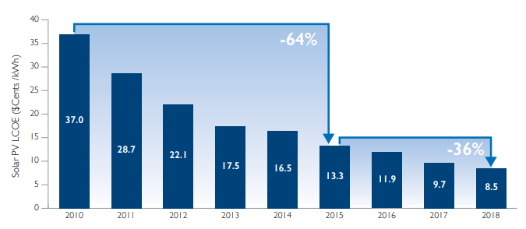
Impact of Project on Environment & Sustainability
Environment:
PV- 40g CO₂/ kWh
Coal- 1000g CO₂/kWh
NG- 640g CO₂/kWh
The cost of PV power must be equal or lower than the grid electricity.
The rise of the solar cell industry in Bangladesh.
Figure: Levelized cost of energy.
S. M. Nayeem Arefin Use of hybrid plasmonic nanoparticle Page ‹#›/29

Slide 27
Limitations
Need experimental implementation of simulations
  Fabrications challenges
    Particle size/shape consistency
    Embedding/Attachment to the absorbing layer
Need for higher computational memory and power to simulate large scale arrays with more control
Need more theoretical explanation for simulation data
S. M. Nayeem Arefin Use of hybrid plasmonic nanoparticle Page ‹#›/29

Slide 28
Summary
g | 388.0258 | 1111.859 | 1116.708
J_{sc} | 101.723 A/m² | 201.269 A/m² | 292.807 A/m²
V_{oc} | 0.7702 V | 0.7734 V | 0.7945 V
S. M. Nayeem Arefin Use of hybrid plasmonic nanoparticle Page ‹#›/29

Slide 29
Future Works
Incorporating p-n junctions, contacts and varying doping concentrations.
Varying the pitch of both top and embedded nanoparticles in large scale array simulations.
Investigating dimer/trimer core-shell nanoparticle complexes.
Investigate the use of core-shell nanoparticles made of alloys.
Investigating the effect of different dielectric shell layers and their thickness.
Experimental Implementation of the simulation study.
S. M. Nayeem Arefin Use of hybrid plasmonic nanoparticle Page ‹#›/29

Slide 30
Publications Generated by Group 9 from EEE 400 Project
Journal:
S.M.N. Arefin, S. Islam, J. Hasan, F. Fairooz, M. Shaky, M.H. Chowdhury. “Using Plasmonic Nanostructures to Enhance Solar Cell Performance – Potential for Significantly Harvesting Solar Energy in Bangladesh”. International Energy Journal – Bangabandhu Chair Special Edition (Energy, Disaster, Climate Change: Sustainability and Just Transitions in Bangladesh) (Eds. Prof. Joyashree Roy, Sheikh Tawhidul Islam & Indrajit Pal).
Conference Papers:
S.M.N. Arefin, S. Islam, F. Fairooz, J. Hasan, M.H. Chowdhury. "Computational study of “sandwich” configuration of plasmonic nanoparticles to enhance the optoelectronic performance of thin-film solar cells." 2020 IEEE Region 10 Symposium (TENSYMP). IEEE, 2020.
S.M.N. Arefin, J. Hasan, S. Islam, F. Fairooz, M.H. Chowdhury. “Influence of Particle Shape on the Ability of Plasmonic Metal Core-Silica Shell Nanoparticles Embedded within the Absorbing Layer to Enhance the Opto-electronic Performance of Thin-Film Solar Cells” 2020 International Conference on Advanced Information & Communication Technology (ICAICT). IEEE, 2020.
F. Fairooz, J. Hasan, S.M.N. Arefin, S. Islam, M.H. Chowdhury. “Use of plasmonic nanoparticles made of aluminum and alloys of aluminum to enhance the optoelectronic performance of thin-film solar cells”. 2020 IEEE Region 10 Symposium (TENSYMP). IEEE, 2020.
M. Shaky, S.M.N. Arefin, M. H. Chowdhury. “Use of Bowtie-shaped Nanoapertures and Spherical Plasmonic Metal Nanoparticles to Improve the Optoelectronic Performance of Thin-film Solar Cells”. 2020 International Conference on Advanced Information & Communication Technology (ICAICT). IEEE, 2020
Fantastic 3 Use of hybrid plasmonic nanoparticle IUBPSL

Slide 31
Upcoming Publications from Group 9
S. Islam, J. Hasan, S.N. Hasan, S.M.N. Arefin, M.H. Chowdhury. “Effect of structural defects in periodic arrays of plasmonic metal nanoparticles in enhancing the opto-electronic performance of thin-film solar cells” (to be submitted to IEEE Tensymp 2021)
J. Hasan, S.N. Hasan, S. Islam, S.M.N. Arefin, M.H. Chowdhury. “Computational investigation of the effect of the angle of incidence of solar radiation on the capability of arrays of plasmonic metal nanoparticles for enhancing the opto-electronic performance of thin-film solar cells” (to be submitted to IEEE Tensymp 2021)
S.M.N. Arefin, J. Hasan, S. Islam and M.H. Chowdhury. “A Study of Plasmonic Core-Shell Nanoparticles Embedded Inside the Absorbing Substrate to Enhance the Opto-electronic Performance of Thin Film Solar Cells” (to be submitted to the Journal of Physics D: Applied Physics)
Fantastic 3 Use of hybrid plasmonic nanoparticle IUBPSL

Slide 32

Any questions, comments or suggestions?
Fantastic 3 Use of hybrid plasmonic nanoparticle IUBPSL

